Slide 1
Interfacing Matrix Keypad with PIC Microcontroller

Slide 2
PIC MICROCONTROLLER
PIC is a family of modified Harvard architecture microcontrollers made by Microchip Technology, derived from the PIC1650 originally developed by General Instrument's Microelectronics Division.
The name PIC initially referred to Peripheral Interface Controller.

Slide 3
All current models use Flash memory for program storage, and newer models allow the PIC to reprogram itself.
Data memory is 8-bit, 16-bit and in latest models, 32-bit wide.

Slide 4
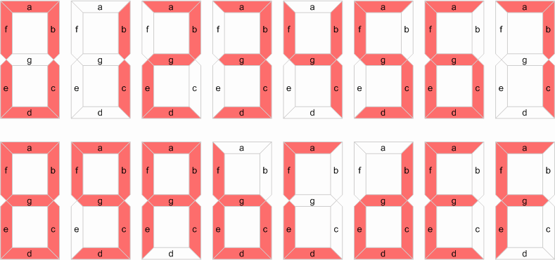

Slide 5
Matrix Keypad
Matrix Keypad is a very useful and user friendly when we want to design certain applications like Calculator, Telephone etc. Matrix Keypad is made by arranging push button switches in rows and columns.
if you want to interface a 4*4 (16 keys) matrix keypad with a microcontroller. In the straight forward way, you will need 16 pins of a microcontroller for that, but by using a simple technique we can reduce it to 8 pins.

Slide 6
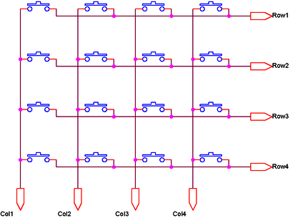
Schematic Diagram of 4*4 matrix keypad

Slide 7
4x4 Key Pad
In this particular example there are 16 switches
Rather than use up all these scarce I/O pins it is hardware efficient to connect these switches in the form of a 4×4 matrix
Without matrix – 16 I/O pins are required
With matrix, total I/O pin count is 8.
Larger keypads show an even greater efficiency gain, with a 64-contact 8 × 8 keyboard needing only 16 I/O pins.

Slide 8

7 – Segment Display
A seven segment display is the most basic electronic display device that can display digits from 0-F.
We find wide application in devices that display numeric information like digital clocks, radio, microwave ovens, electronic meters etc.

Slide 9
The most common configuration has an array of eight LEDs arranged in a special pattern to display these digits.
They are laid out as a squared-off figure ‘8’.
Every LED is assigned a name from 'a' to 'h' and is identified by its name.
Seven LEDs 'a' to 'g' are used to display the numerals while eighth LED 'h' is used to display the dot/decimal.

Slide 10
A seven segment is generally available in ten pin package.
While eight pins correspond to the eight LEDs, the remaining two pins (at middle) are common and internally shorted.
These segments come in two configurations, namely, Common cathode (CC) and Common anode (CA).

Slide 11
In CC configuration, the negative terminals of all LEDs are connected to the common pins.
The common is connected to ground and a particular LED glows when its corresponding pin is given high.
In CA arrangement, the common pin is given a high logic and the LED pins are given low to display a number.

Slide 12
Working of 4x4 Key Pad
The four rows are read in via RB7:4 with internal pull-up resistors enabled.
The three columns connected to RB0:3 can be individually selected in turn by driving the appropriate pin low, thus scanning through the matrix.
This is called key board scanning.
The switch contacts are normally open and, because of the pull-up resistors, read as logic 1.

Slide 13
Continued…
When a switch connected to a low column line is closed then the appropriate row line is low.
Once the closed key row has been detected the column : row intersection is known (i.e. the key that is pressed is identified).

Slide 14
Algorithm For Scanning A Key
1. Two global variables KEY_COUNT,
PATTERN
2. Key 1 is the first key
3. Set initial KEY_COUNT = 1
4. Set initial PATTERN = b’11110111’
5. Start a loop – SLOOP
6. Output PATTERN to PORTB
7. Move KEY_COUNT to W
8. Check ROW1 - RB7
9. IF zero THEN found the key, exit the
subroutine with Key identifier, ELSE increment
KEY_COUNT by 4.

Slide 15
Continued…
10. Check ROW2 – RB6
11. IF zero THEN found the key, exit the subroutine with Key identifier, ELSE increment KEY_COUNT by 4.
12. Check ROW3 – RB5
13. IF zero THEN found the key, exit the subroutine with Key identifier, ELSE increment KEY_COUNT by 4.
14. Check ROW4 – RB4
15. IF zero THEN found the key, exit the subroutine with Key identifier, ELSE increment KEY_COUNT by 4.

Slide 16
Continued…
16. If no closed key, W = -1.
17. Advance KEY_COUNT one column.
18. Shift (right) scan pattern once ->.
19. Check - has the 0 reached RB0?
20. IF not DO another column. Go to SLOOP.
21. IF yes, return with KEY_COUNT in W.

Slide 17
a
Yes
RB7 = 0
No
W = W + 4
Yes
RB6 = 0
SCAN_IT
KEY ID = W
No
W = W + 4
KEY_COUNT = 1
PATTERN = b’11110111
Yes
RB5 = 0
No
O/P
PATTERN to PORTB
W = W + 4
Yes
RB4 = 0
W = KEY_COUNT
No
W = h’FF
KEY_COUNT + 1
PATTERN >> 1
a
No
RB0 = 0
Yes
KEY ID = W

Slide 18
Thank You
Done by
Jagadeesh(14052)
Sai Kaushik(14059)
H.Chaithanya(14028)
Mrudula (14010)
Anand.S(14009)

